Slide 1
U2-OS
Prof. Variza Negi

Slide 2
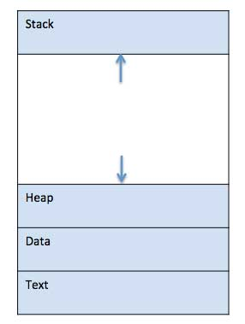
What is a Process?
A process is a program in execution.
Process is not as same as program code but a lot more than it.
A process is an 'active' entity as opposed to program which is considered to be a 'passive' entity.
Attributes held by process include hardware state, memory, CPU etc.

Slide 3
What is a Process?
Process memory is divided into four sections for efficient working :
The Text section is made up of the compiled program code and program counter, read in from non-volatile storage when the program is launched.
The Data section is made up the global and static variables, allocated and initialized prior to executing the main.
The Heap is used for the dynamic memory allocation, and is managed via calls to new, delete, malloc, free, etc.
The Stack is used for local variables or is for temporary storage. Space on the stack is reserved for local variables when they are declared.

Slide 4
Different Process States
Processes in the operating system can be in any of the following states:
NEW- The process is being created.
READY- The process is waiting to be assigned to a processor.
RUNNING- Instructions are being executed.
WAITING- The process is waiting for some event to occur(such as an I/O completion or reception of a signal).
TERMINATED- The process has finished execution.

Slide 5
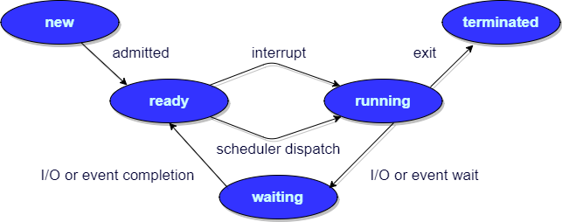
Process Life Cycle

Slide 6
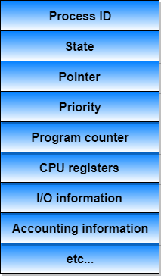
Process Control Block
A Process Control Block is a data structure maintained by the Operating System for every process.
The PCB is identified by an integer process ID (PID).
A PCB keeps all the information needed to keep track of a process.
The PCB is maintained for a process throughout its lifetime, and is deleted once the process terminates.

Slide 7
Information contained in a PCB
Information | Description
Process State | The current state of the process i.e., whether it is ready, running, waiting, or whatever.
Process privileges | This is required to allow/disallow access to system resources.
Process ID | Unique identification for each of the process in the operating system.
Pointer | A pointer to parent process.
Program Counter | Program Counter is a pointer to the address of the next instruction to be executed for this process.
CPU registers | Various CPU registers (accumulators, index registers, general purpose registers etc.) where process need to be stored for execution for running state.
CPU Scheduling Information | Process priority and other scheduling information which is required to schedule the process.
Memory management information | This includes the information of page table, memory limits, Segment table depending on memory used by the operating system.
Accounting information | This includes the amount of CPU used for process execution, time limits, execution ID etc.
IO status information | This includes a list of I/O devices allocated to the process.

Slide 8
Context Switching
Context Switching involves storing the context or state of a process so that it can be reloaded when required and execution can be resumed from the same point as earlier.
This is a feature of a multitasking operating system and allows a single CPU to be shared by multiple processes.

Slide 9
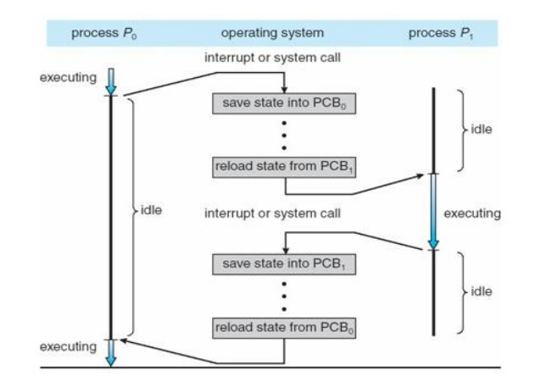
Context Switching

Slide 10
Threads, Thread Management, Process vs Threads
Operating Systems: Internals and Design Principles, 6/E William Stallings
Notes:
These slides are intended to help a teacher develop a presentation. This PowerPoint covers the entire chapter and includes too many slides for a single delivery. Professors are encouraged to adapt this presentation in ways which are best suited for their students and environment.

Slide 11
Processes and Threads
A process is an active program i.e. a program that is under execution. It is more than the program code as it includes the program counter, process stack, registers, program code etc. Compared to this, the program code is only the text section.
A thread is a lightweight process that can be managed independently by a scheduler. It improves the application performance using parallelism. A thread shares information like data segment, code segment, files etc. with its peer threads while it contains its own registers, stack, counter etc.

Slide 12
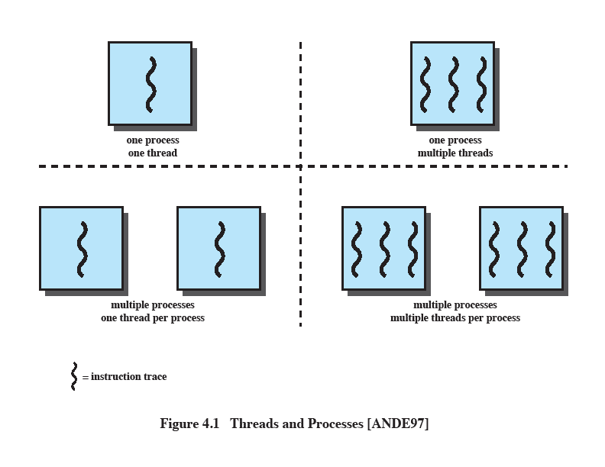
Multithreading
The ability of an OS to support multiple, concurrent paths of execution within a single process.
e.g.
MS DOS (single process, single thread)
Unix (multiple, single threaded processes)
Notes:
Multithreading refers to the ability of an OS to support multiple, concurrent paths of execution within a single process.

Slide 13
Processes
A virtual address space which holds the process image
Protected access to
Processors,
Other processes,
Files,
I/O resources
Notes:
In a multithreaded environment, a process is defined as the unit of resource allocation and a unit of protection.

Slide 14
One or More Threads in Process
Each thread has
An execution state (running, ready, etc.)
Saved thread context when not running
An execution stack
Some per-thread static storage for local variables
Access to the memory and resources of its process (all threads of a process share this)
Notes:
Within a process, there may be one or more threads, each with the following:
• A thread execution state (Running, Ready, etc.).
• A saved thread context when not running;
one way to view a thread is as an independent program counter operating within a process.

Slide 15
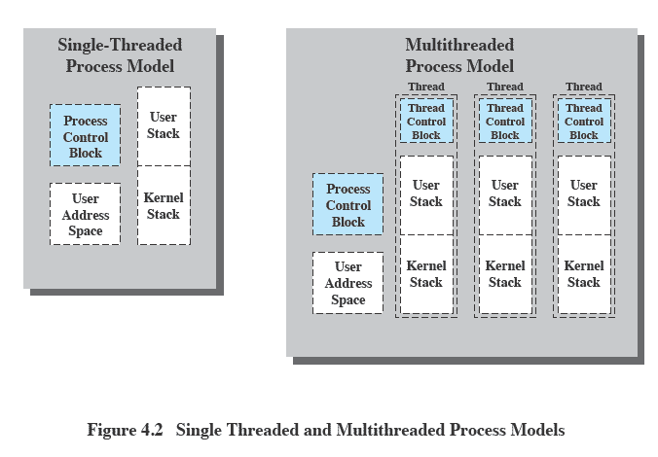
Threads vs. processes
Notes:
Distinction between threads and processes from the point of view of process management.
In a single-threaded process model, the representation of a process includes
its process control block
user address space,
user and kernel stacks to manage the call/return behaviour of the execution of the process.
While the process is running, it controls the processor registers. The contents of these registers are saved when the process is not running.
In a multithreaded environment,
there is still a single process control block and user address space associated with the process,
but separate stacks for each thread,
as well as a separate control block for each thread containing register values, priority, and other thread-related state information.
Thus, all of the threads of a process share the state and resources of that process.
They reside in the same address space and have access to the same data.
When one thread alters an item of data in memory, other threads see the results if and when they access that item.
If one thread opens a file with read privileges, other threads in the same process can also read from that file.

Slide 16
Threads vs process (process management point of view)
In a single-threaded process model, the representation of a process includes
its process control block
user address space,
user and kernel stacks to manage the call/return behaviour of the execution of the process.
While the process is running, it controls the processor registers. The contents of these registers are saved when the process is not running.

Slide 17
In a multithreaded environment
there is a single process control block and user address space associated with the process,
but separate stacks for each thread,
as well as a separate control block for each thread containing register values, priority, and other thread-related state information.

Slide 18
Thus, all of the threads of a process share the state and resources of that process.
They reside in the same address space and have access to the same data.
When one thread alters an item of data in memory, other threads see the results if and when they access that item.
If one thread opens a file with read privileges, other threads in the same process can also read from that file.

Slide 19
Benefits of Threads
Takes less time to create a new thread than a process
Less time to terminate a thread than a process
Switching between two threads takes less time that switching processes
Threads can communicate with each other
without invoking the kernel
Notes:
If there is an application or function that should be implemented as a set of related units of execution,
it is far more efficient to do so as a collection of threads - rather than a collection of separate processes.

Slide 20
Thread Execution States
States associated with a change in thread state
Spawn (another thread)
Block
Unblock
Finish (thread)
Deallocate register context and stacks
Notes:
A significant issue is whether the blocking of a thread results in the blocking of the entire process.
If one thread in a process is blocked, does this prevent the running of any other thread in the same process even if that other thread is in a ready state?
Clearly, some of the flexibility and power of threads is lost if the one blocked thread blocks an entire process.

Slide 21
Categories of Thread Implementation
User Level Thread (ULT)
Kernel level Thread (KLT) also called:
kernel-supported threads
lightweight processes.

Slide 22
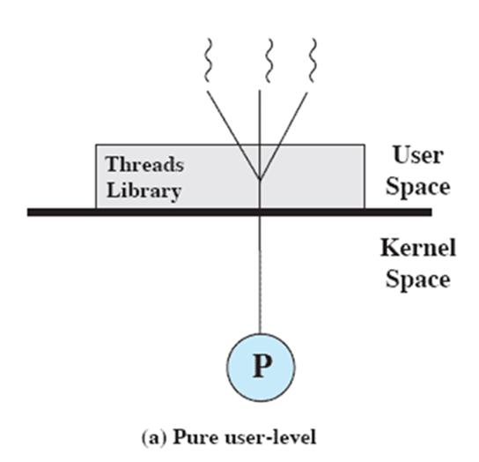
User-Level Threads
All thread management is done by the application
The kernel is not aware of the existence of threads

Slide 23
Advantages of ULTs over KLTs
Saves the overhead of two modes switches (user to kerner; kernel back to user) as thread management happens at user address space
Scheduling can be application specific
ULTs can run on any OS; no changes required to be done at kernel

Slide 24
Disadvantages of ULTs
When a ULT executes a system call, the thread gets blocked and also all the within the process are blocked
In ULT strategy, a multithreaded application cannot take advantages of multiprocessing. Only a single thread within the process can execute at a time.
NOTE: to overcome the problem of blocking threads we can use JACKETING. (EXPLORE ??)

Slide 25
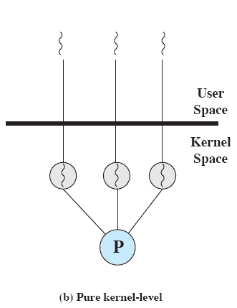
Kernel-Level Threads
Kernel maintains context information for the process and the threads
No thread management done by application
Scheduling is done on a thread basis
Windows is an example of this approach
Notes:
The kernel maintains context information for the process as a whole and for individual threads within the process.
Scheduling by the kernel is done on a thread basis.
-

Slide 26
Advantages of KLT
The kernel can simultaneously schedule multiple threads from the same process on multiple processors.
If one thread in a process is blocked, the kernel can schedule another thread of the same process.
Kernel routines themselves can be multithreaded.

Slide 27
Disadvantage of KLT
The transfer of control from one thread to another within the same process requires a mode switch to the kernel

Slide 28
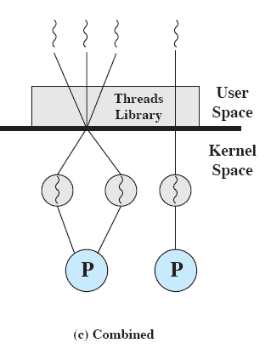
Combined Approaches
Thread creation done in the user space
Bulk of scheduling and synchronization of threads by the application
Example is Solaris
Notes:
In a combined approach, multiple threads within the same application can run in parallel on multiple processors,
and a blocking system call need not block the entire process.
If properly designed, this approach should combine the advantages of the pure ULT and KLT approaches while minimizing the disadvantages.

Slide 29
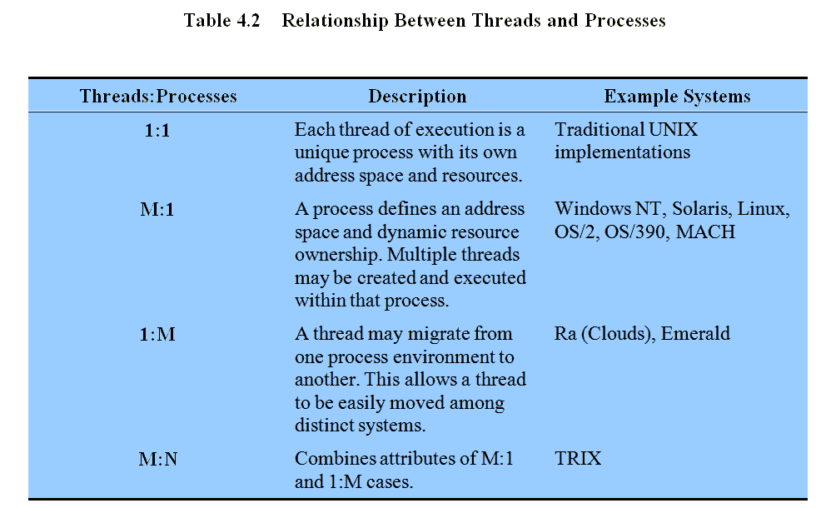
Relationship Between Thread and Processes
Notes:
The concepts of resource allocation and dispatching unit have traditionally been embodied in the single concept of the process; that is, as a 1 : 1 relationship between threads and processes.
There has been much interest in providing for multiple threads within a single process, which is a many-to-one relationship
.
However, as the table shows, the other two combinations have also been investigated, namely,
a many-to-many relationship and
a one-to-many relationship.

Slide 30
The major differences between a process and a thread are given as follows:
Comparison Basis | Process | Thread
Definition | A process is a program under execution i.e an active program. | A thread is a lightweight process that can be managed independently by a scheduler.
Context switching time | Processes require more time for context switching as they are more heavy. | Threads require less time for context switching as they are lighter than processes.
Memory Sharing | Processes are totally independent and don’t share memory. | A thread may share some memory with its peer threads.
Communication | Communication between processes requires more time than between threads. | Communication between threads requires less time than between processes .

Slide 31
The major differences between a process and a thread are given as follows:
Comparison Basis | Process | Thread
Blocked | If a process gets blocked, remaining processes can continue execution. | If a user level thread gets blocked, all of its peer threads also get blocked.
Resource Consumption | Processes require more resources than threads. | Threads generally need less resources than processes.
Dependency | Individual processes are independent of each other. | Threads are parts of a process and so are dependent.
Data and Code sharing | Processes have independent data and code segments. | A thread shares the data segment, code segment, files etc. with its peer threads.
Treatment by OS | All the different processes are treated separately by the operating system. | All user level peer threads are treated as a single task by the operating system.
Time for creation | Processes require more time for creation. | Threads require less time for creation.
Time for termination | Processes require more time for termination. | Threads require less time for termination.

